Slide 1
Data Model of Big Data Systems
Pravin Y Pawar

Slide 2
Properties of Data
Three Properties
Rawness
Fine grained data
Many interesting queries can be answered
Unstructured data is more rawer than structured data
Immutability
No deletion or updates to data, only new addition
Original data is untouched
Easy to retrieve back from the failures / mistakes
No indexing required, enforcing simplicity
Eternity
Consequence of immutability
Data is always pure and true
Achieved with adding timestamp with the data
Source : Big Data , Nathan Marz

Slide 3
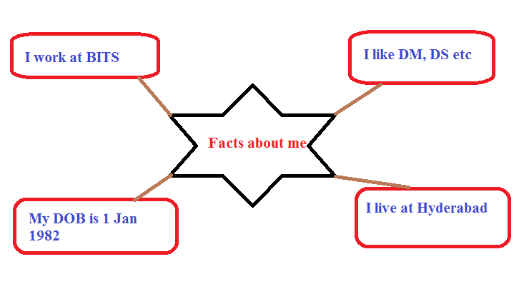
Fact based Model for Data
Facts
Fundamental unit of data
Data can not derived from anything else
Fact is atomic and time stamped
Can be made unique by adding unique identifier to it
Example facts
I work for BITS Pilani
My DOB is 1 January 1982
I currently live in Hyderabad
I was living at Pune between 2010 to 2015
I have interest in subjects like data mining, data science etc

Slide 4
Fact based Model for Data (2)
Benefits
Fact based model
Stores raw data as atomic facts
Makes facts immutable by adding time stamp value to it
Makes it uniquely identifiable by attaching identifier
Benefits
Data is query able at any time
Data is tolerant to human errors
Data can be stored both in structured and unstructured formats

Slide 5
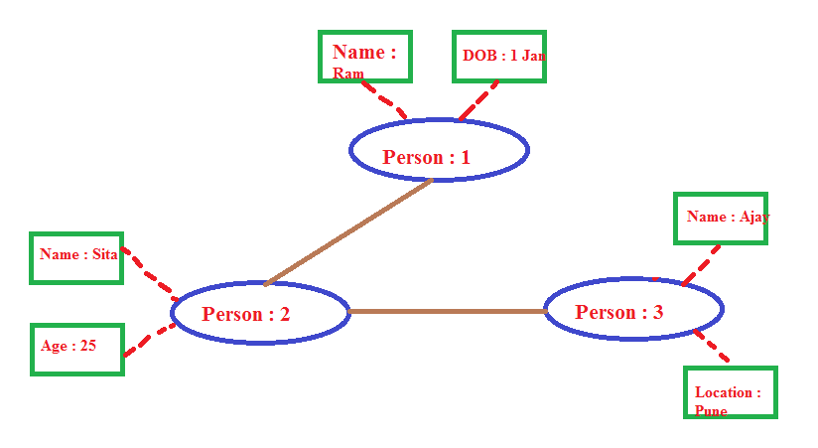
Fact based Model for Data (3)
Structure / Schema
Graph schemas captures the structure of dataset stored using fact based model
Depicts the relationship between nodes, edges and properties
Nodes
Entities in system , for example, person
Edges
Relationship between entities,
For example, person A knows person B
Properties
Information about entities

Slide 6
Thank You!
In our next session: Generalized Architecture of Big Data Systems

